Slide 1
Automating Continuous Delivery with ElectricCommander
Lessons From the Field

Slide 2
Overview
Overall process practices
Professional Services
Miscellaneous advices
Notes:
Show of hands: who is a user of Commander

Slide 3
Introduction Transformative Benefits
ElectricCommander
3
+3
Background
20+ years in software
EDA
Customer
2+ years at Electric Cloud
Awesome math skills
+3
= 6
Notes:
3rd presentation
3 conferences as a customer
3 as an employee
6th conference
Now that my math skills have been established, let me tell you about best practices I gather working around the world with customer (Asia, Europe, US and Boston)

Slide 4
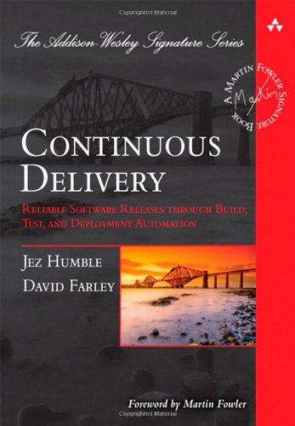
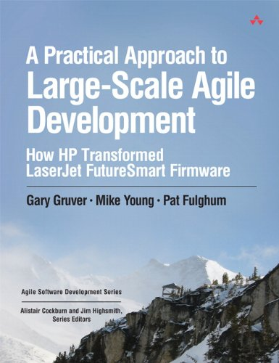
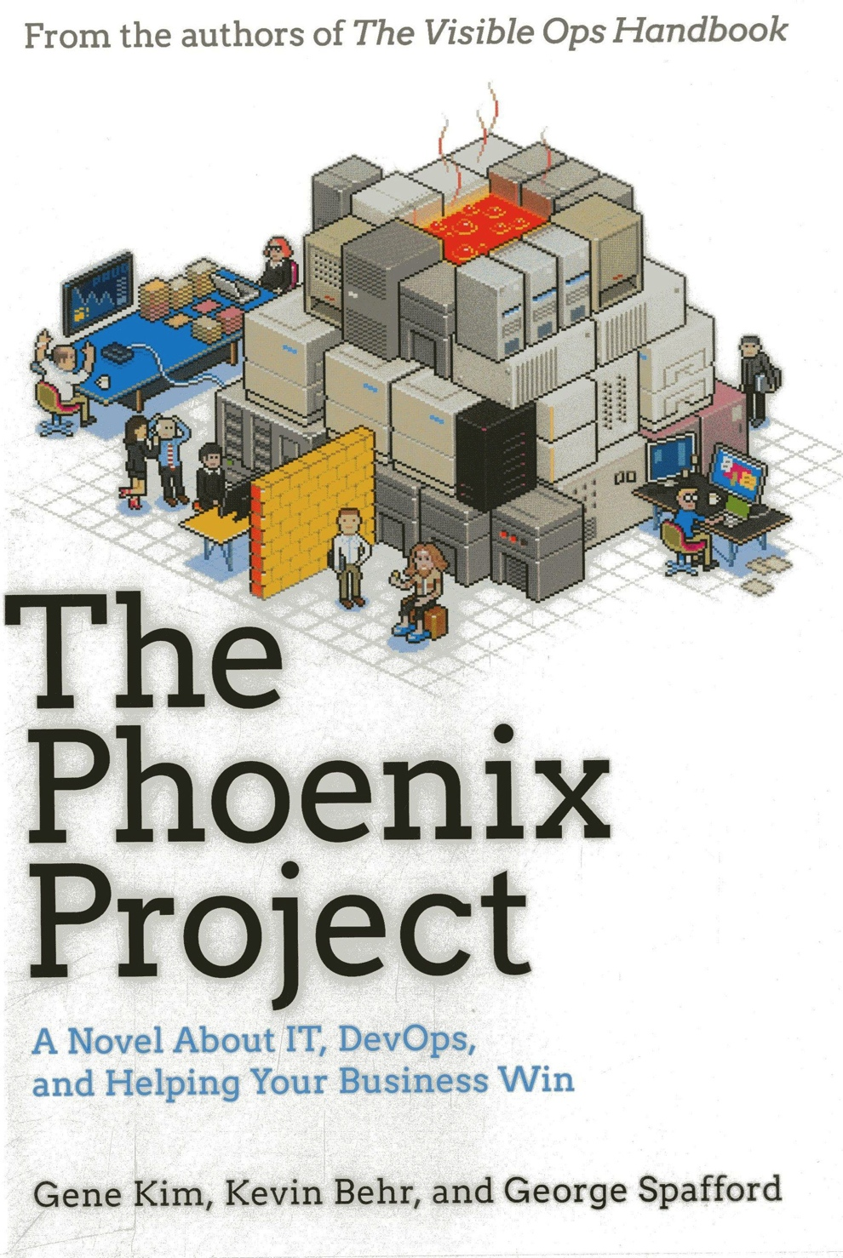
Resources
Notes:
The Phoenix project by Gene Kim, Kevin Behr &George Spafford
Continuous Delivery by Jez Humble & David Farley
A Practical Approach to Large-Scale Agile Development: How HP Transformed LaserJet FutureSmart Firmware
by Gary Gruver , Mike Young , Pat Fulghum

Slide 5

Photo ©2007 Derek Ramsey
Notes:
American Sweetgum (Liquidambar styraciflua)
Photo ©2007 Derek Ramsey

Slide 6
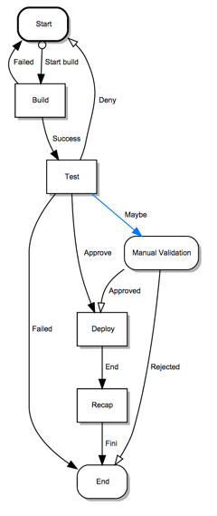
Low hanging fruits
You cannot do everything immediately
What is the longest part of your process?
Build?
Test?
Maybe waiting for somebody approval?
Solution: workflow
Focus your energy on the biggest reward
Electric Cloud Proprietary & Confidential
Notes:
Workflow and notifier may help you
You can also transition on timer (wtf)

Slide 7
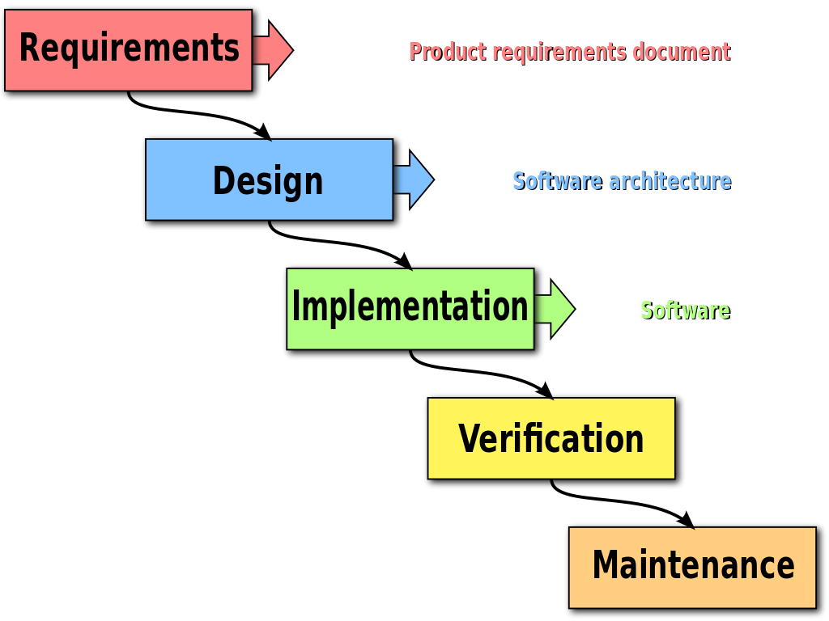
©Peter Lemp & Paul Smith
Notes:
©Peter Lemp & Paul Smith
https://en.wikipedia.org/wiki/File:Waterfall_model.svg

Slide 8
Do Not "Waterfall" your Agile process
You're typically implementing an Agile process
So why use a waterfall process for your Commander implementation
Do not over think every detail of your implementation
Learn by trying
Iterate
Deliver small chunks

Slide 9
Commander is now on the critical path
Treat Commander as any other part of your delivery
Don't break your process due to a bad step change
Use a development Commander server
projectAsCode (EC-Admin)
Use plugin versioning

Slide 10



Commander Development Life Cycle
Develop
Testing
Dev Machine
Prod Server(s)
Dev Server
Install & Promote Plugin
create & load
Plugin
extract Project
& check in CMS
CMS Server

Slide 11
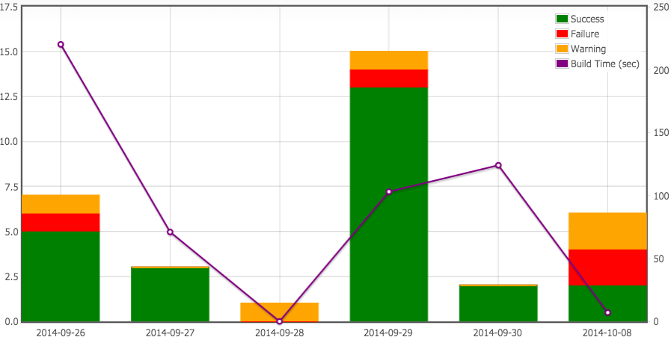
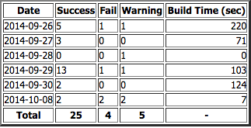
A picture is worth a thousand words
Notes:
Very simple example of using flot with Unplug

Slide 12
Reports
For whom do you write your report?
Developer or Director
Where do they spend their time usually?
Commander or Reporting Software
Technology
GWT, unplug, CI Dashboard, BIRT
Refresh Rate
static or dynamic
Notes:
Reports are important

Slide 13
Properties
Properties are meta-data attached to objects (jobs, users, …)
No limitation
"Because you can does not mean you should"
Used to store:
job data for reporting
data between run (like counter)
Global values (configuration)
Can be combined in fields (Resources, templates, …)
Notes:
Example:
SVN checked out file list
Images

Slide 14
Naming Conventions and Properties
Properties and parameters usage can be nested
For example:
a platform parameter: Linux, Windows
a pool: pool_Linux, pool_Windows
Resource: pool_$[platform]
A file path: $[/myProject/$[platform]/configFile]
Notes:
Clever usage of parameters can make your life easier

Slide 15
Test, Test, Test
Enough said?
Usually a time sink but easy to parallelize
No CI/CD without test
Free testers time by automating manual steps
Mix automatic and manual transitions
> 90%: automatic to next stage
< 80%: automatic failure
80>%<90: manual validation
Notes:
I've seen testers used to verify a sentence in a text file
Commander Dynamic steps
Accelerator

Slide 16
Test Implementation
If you can run several tests on one machine
=> Accelerator
If you can run only one test on one machine
=> Commander + dynamic steps
Webinar: http://youtu.be/s0CpfceeYmE

Slide 17
Think ACLs
Plan early even if you do not implement immediately
ACL at project level is easier to manage
Good naming convention and EC-Security can make your life easier
"project" : [
{ "pattern" : "USD.*",
"acl" : [
{ "group" : "USD-Test", "access" : [ "allow", "inherit", "allow", "inherit" ] },
{ "role" : "RE", "access" : [ "allow", "allow", "allow", "inherit"] } ] }
],
Notes:
Commander/Deploy has this notion of ACL on every object

Slide 18

TOOLS
Progress
Notes:
©John Englart (Takver)
https://www.flickr.com/photos/takver/
https://flic.kr/p/cngsRJ

Slide 19
People
Impediment to change is people
"Why do I need to use this new tool?"
Include your internal customers and try to give them something they want.
But don't forget your mandate:
"we've always done it this way" is not a good reason to stay stuck in the past.
Notes:
Hammer: because the boss said so
Honey: what is your pain?
Not everybody is Henry Ford or Steve Jobs
Take advantage of new tools to implement new ideas and improve process

Slide 20
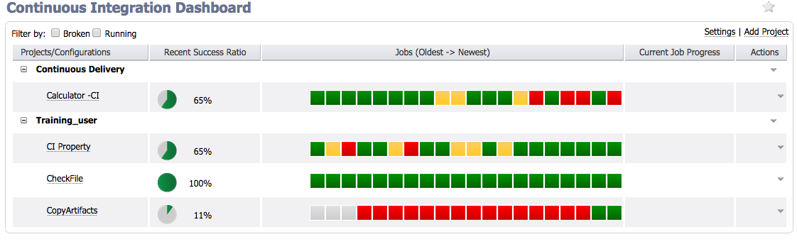
Red is information (or the influence of metric)
A single broken build is not an issue in itself
Notes:
3 weeks of red is bad.
Why are you measuring broken build?
Does it affect how often people check in? => bigger changes
Are people turning test off to avoid Red?
Dev A makes changes to code and runs preflight. The preflight is successful, all goes well and code is checked in. Dev A continues writing code.
Dev B makes changes to some of the same files, runs preflight and it fails! Oh no! Dev B does not check in code, and works on implementing fixes.
Dev A finishes a new set of changes and runs preflight, while Dev B is still fixing problems with his/her code. Dev A’s preflight passes and all goes well.
Dev B finally fixes his/her code and runs preflight successfully. However, when Dev B tries to check-in the code, he notices conflicts because Dev A had already changed the same code. Dev B must now fix these conflicts. If Dev B is smart than he fixes them properly and code doesn’t break, but does developer B also run the same tests Dev A ran to make sure he didn’t break Dev A’s changes?

Slide 21
Red is information (2)
Preflight can help but it's not a panacea
Failure is also a valid indicator
Team Goal: Fix it
Blog: http://electric-cloud.com/blog/2014/10/preflight-good-idea
Notes:
3 weeks of red is bad.
Why are you measuring broken build?
Does it affect how often people check in? => bigger changes
Are people turning test off to avoid Red?
Dev A makes changes to code and runs preflight. The preflight is successful, all goes well and code is checked in. Dev A continues writing code.
Dev B makes changes to some of the same files, runs preflight and it fails! Oh no! Dev B does not check in code, and works on implementing fixes.
Dev A finishes a new set of changes and runs preflight, while Dev B is still fixing problems with his/her code. Dev A’s preflight passes and all goes well.
Dev B finally fixes his/her code and runs preflight successfully. However, when Dev B tries to check-in the code, he notices conflicts because Dev A had already changed the same code. Dev B must now fix these conflicts. If Dev B is smart than he fixes them properly and code doesn’t break, but does developer B also run the same tests Dev A ran to make sure he didn’t break Dev A’s changes?

Slide 22
Artifacts
Build only once
if not, are you sure it's build the same?
Create artifacts
Commander records creator and reader jobs for accountability
Use property to keep track of progress in pipeline
Also help with potential cleaning
Notes:
Artifactory usage:
Wanted to replicate our system

Slide 23
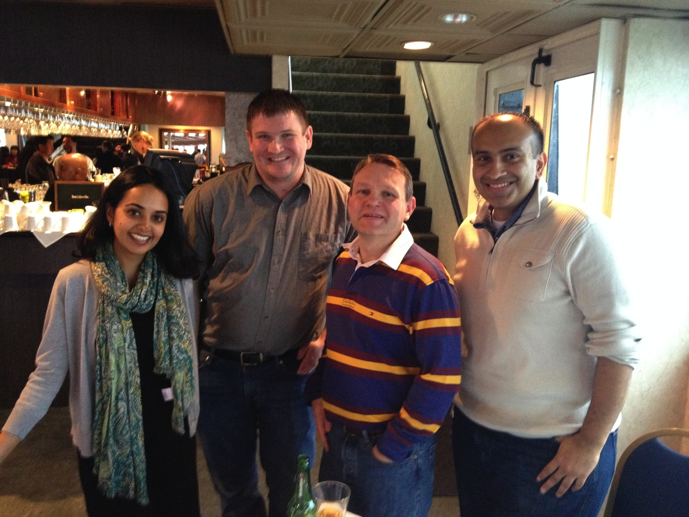
What's next?
I'm biased but:
we use Commander every day
we work with many customers
we will guide you
we will challenge you
Hire one, get a team
Hire one, get a company
Contact your Sales Executive
to book the PS Team

Slide 24
Additional Help
http://www.electric-cloud.com/blog
http://electric-cloud.com/resources/webinars/
http://ask.electric-cloud.com

Slide 25
Summary
“No Matter your Continuous Delivery Complexity,
We believe ElectricCommander can help you achieve Success”
PS
Notes:
BROADCOM customer quote – not public!

Slide 26
Q & A

Slide 27

Thank You

